Slide 1
CLASSIFIED
Classified is Jordi Beernink, Thijs Werrij, Roel Bouman, Jeffrey Luppes, and Gerdriaan Mulder.
Sberbank Russian Housing Market Competition
https://www.kaggle.com/c/sberbank-russian-housing-market

Slide 2
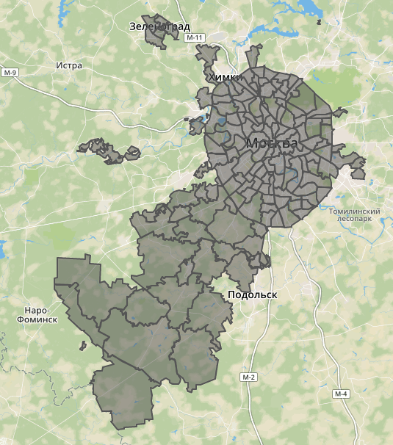
Sberbank Russian Housing Market
Kaggle Competition ending June 29
Data from the Russian Property Market
Spatial element: different areas of Moscow
Time: Data is from 2011 to 2015.
Macro-economic data: information on Russia’s financial sector and macroeconomy
To predict: Price.
But the test set is from 2015 to 2016!

Slide 3
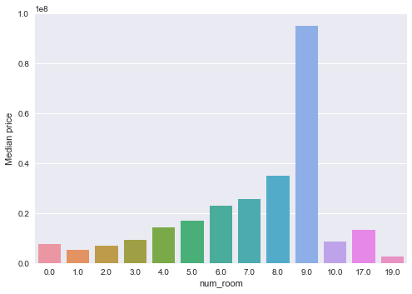
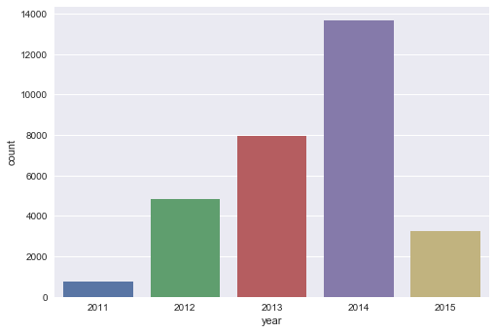
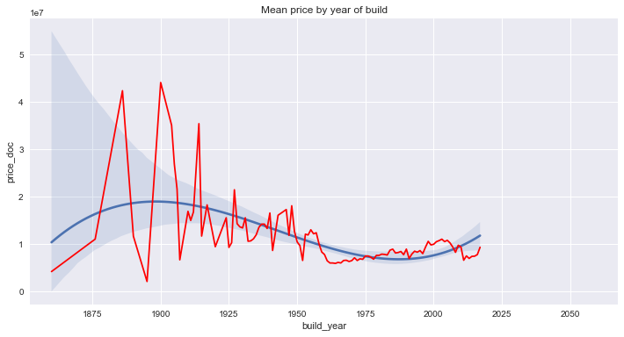
Step One: Data Exploration
30471 objects with 291 features from 146 districts
Exploratory work: Python / Apache Spark / Leaflet.js

Slide 4
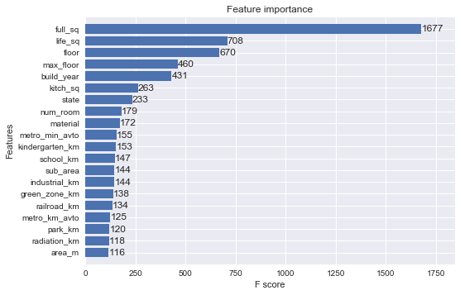
Approach
Missing data: replacing with representative values, pruning, with respect to the data
Implementing some go-to tools to see what we get: e.g. XGBoost, RF, DNN
Feature importance (XGBoost)

Slide 5
Results
Current rank:
~720 of ~2400

Slide 6
From here onwards
Ensembles (more pipeline work!)
Dealing with anomalous data
Addressing the test set / training set issues
Close eye on other competitions! (e.g. Zestimate)

Slide 7
Team Classified
Sberbank Housing Prices
Challenges: Data quality, test set different from train
Approach: Ensembles, exploring data enrichment
Current rank about 720 of 2400

